Slide 1
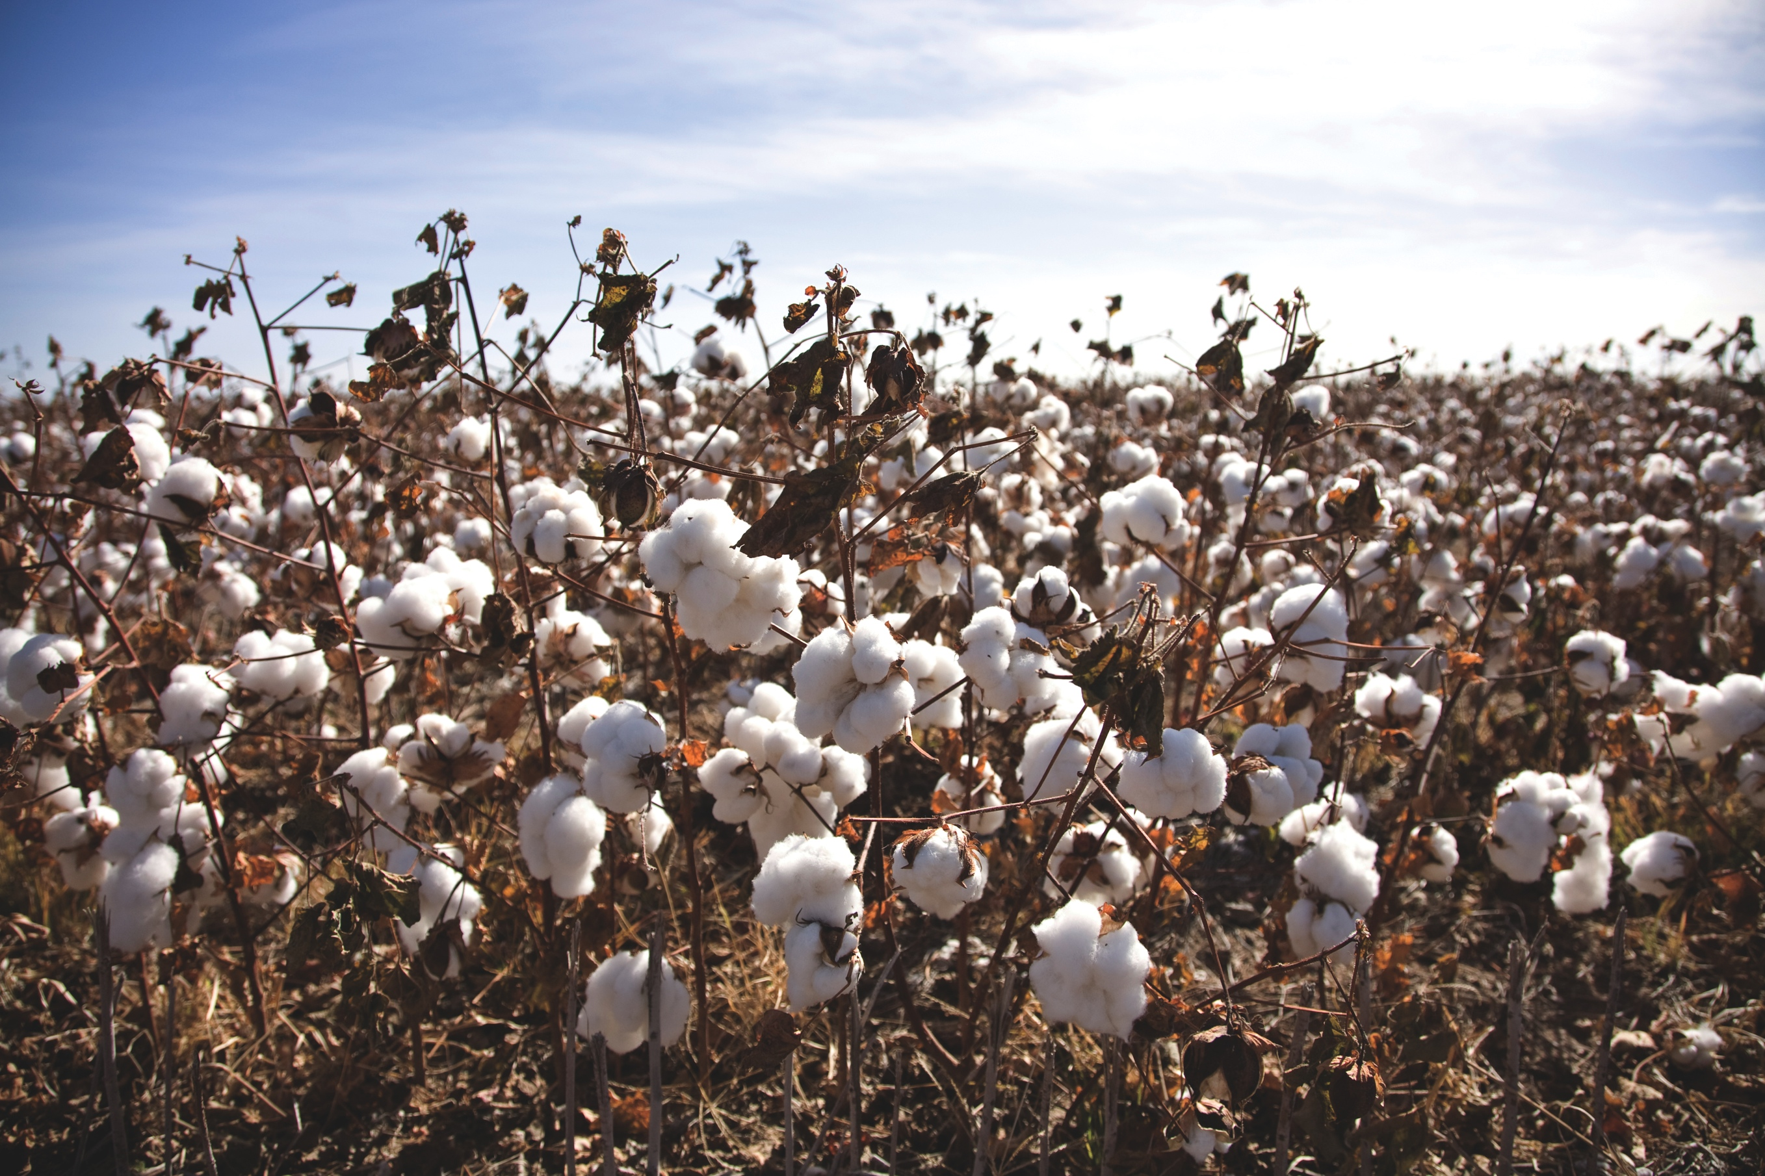
Title John Doe, Department of This and That, New Mexico State University
College or Department Name
™
Poster No. 1234
Introduction
Laorper ostrud tisi. Sis augiamet ad mod el ipsusci duissent iril ulla feugigiat adipit praessit iriurerilis dit am dio conse delessed et euipsummy gait alisl utat nim il eraese feu feum velit lut lor senibh esequipit volobore commolortie ea feugait amconsectem venisl iuscips ustrud erciliquamet incillum quam illut nullum diamcon etummy nim zzrillam, commodolor alit venim velisciduis nonsed te feu facinibh et
Hypothesis or Objectives
Laorper ostrud tisi. Sis augiamet ad mod el ipsusci duissent iril ulla feugigiat adipit praessit iriurerilis dit am dio conse delessed et euipsummy gait alisl utat nim il eraese feu feum velit lut lor senibh esequipit volobore commolortie ea
Laorper ostrud tisi. Sis augiamet ad mod el ipsusci duissent iril ulla feugigiat adipit praessit iriurerilis dit am dio conse
delessed et niametum irit, commodigna alismod ipsummy nullaor ipsuscidunt acing eratem inim quipit ut ut ad elit,
Materials and Methods
Laorper ostrud tisi. Sis augiamet ad mod el ipsusci duissent iril ulla feugigiat adipit praessit iriurerilis dit am dio conse delessed et euipsummy gait alisl utat nim il eraese feu feum velit lut lor senibh esequipit volobore commolortie ea feugait amconsectem venisl iuscips ustrud erciliquamet incillum quam illut nullum diamcon etummy nim zzrillam, commodolor alit venim velisciduis nonsed te feu facinibh et
Conclusions
euipsummy gait alisl utat nim il eraese feu feum velit lut lor senibh esequipit volobore commolortie ea feugait diamcon etummy nim zzrillam, commodolor alit venim velisciduis nonsed te feu facinibh et irit nos nonsequisamconsectem venisl iuscips ustrud erciliquamet incillum quam illut nullum
euipsummy gait alisl utat nim il eraese feu feum velit lut lor senibh esequipit volobore commolortie ea feugait amconsectem venisl iuscips ustrud erciliquamet incillum quam illut nullum diamcon etummy nim zzrillam, commodolor alit venim velisciduis nonsed te feu facinibh et irit nos nonsequis am
Implications
Laorper ostrud tisi. Sis augiamet ad mod el ipsusci duissent iril ulla feugigiat adipit praessit iriurerilis dit am dio conse delessed et euipsummy gait alisl utat nim il eraese feu feum velit lut lor senibh esequipit volobore commolortie ea feugait amconsectem venisl iuscips ustrud erciliquamet incillum quam illut nullum diamcon etummy nim zzrillam, commodolor alit venim velisciduis nonsed te feu facinibh et
Data and Results
Laorper ostrud tisi. Sis augiamet ad mod el ipsusci duissent iril ulla feugigiat adipit praessit iriurerilis dit am dio conse delessed et euipsummy gait alisl utat nim il eraese feu feum velit lut lor senibh esequipit volobore commolortie ea feugait amconsectem venisl iuscips ustrud erciliquamet incillum quam illut nullum diamcon etummy nim zzrillam, commodolor alit venim velisciduis nonsed te feu facinibh et
Grant number and Citations
Laorper ostrud tisi. Sis augiamet ad mod el ipsusci duissent iril ulla feugigiat adipit praessit iriurerilis dit am dio conse delessed et euipsummy gait alisl utat nim il eraese feu feum velit lut lor senibh esequipit volobore commolortie ea

Slide 2
TIPS
College of Engineering, Department Name
™
Poster No. 1234
Introduction
Try to use bullet points and short sentences rather than long lengthy paragraphs.
Conclusions
Keep your conclusion at the top and keep it within one or two sentences.
Implications
It’s ok to use more than one image and multiple graphs, but make sure they are easy to read.
DO NOT RESIZE OR MOVE THE NMSU LOGO AND TAGLINE.
Data and Results
Make your graphs simple and easy to read. Make sure the file is large enough so it does not pixelate when you print.
Need help?
Feel free to email the College of Engineering media specialist for additional tips and help on your research poster. Please note, they cannot make the poster for you.
Contact: Vladimir Avina, vlad23@nmsu.edu
Grant number and Citations
Think about using QR Codes to save space and drive people to other work you would like to promote.

